Slide 1
U.S. Goods Returned (USGR)

Slide 2
Overview
The expression "U.S. Goods Returned" (USGR) could be interpreted as meaning "all goods grown, produced or fabricated in the U.S., exported from the U.S. and subsequently returned.” However, to enable correct administration and interpretation of the HTSUS, many departures are made from this strict interpretation.
This training will focus on five tariff items from the first two subchapters of HTSUS Chapter 98. In Subchapter I, titled “Articles Exported and Returned, Not Advanced or Improved in Condition; Animals Exported and Returned” subheadings, 9801.00.10 and 9801.00.25, HTSUS will be reviewed. In Subchapter II, titled “Articles Exported and Returned, Advanced or Improved Abroad” this module will focus on subheadings, 9802.00.40, 9802.00.50, and 9802.00.80, HTSUS. In general the difference between the returned goods falling into one of these two subchapters is whether or not the goods were advanced or improved in condition.

Slide 3
List of Lessons
• Lesson 1: 9801.00.10, Returned Goods Without being Advanced or Improved (Pages 2 - 18)
• Lesson 2: 9801.00.25, Returned Goods Not Conforming to Samples or Specifications (Pages 19 – 23)
• Lesson 3: 9802.00.40 and 9802.00.50, Goods Exported and Returned after Repairs or Alterations (Pages 24 – 32)
• Lesson 4: 9802.00.80, Imported Goods Assembled from U.S. Components (pages 33 – 47)

Slide 4
Lesson 1: 9801.00.10, Returned Goods Without being Advanced or Improved
Provision: “9801.00.10 Products of the United States when returned after having been exported, or any other products when returned within 3 years after having been exported, without having been advanced in value or improved in condition by any process of manufacture or other means while abroad” (Duty Free)
Statistical suffixes used with this subheading further describe the goods. 9801.00.10 must be read in conjunction with the appropriate chapter and sub-chapter notes contained in the HTSUS. The tariff numbers assigned to the articles exported and returned under subheading 9801.00.10, HTSUS, are as follows:
• 9801.00.1010 – Articles previously exported with intent to reimport after temporary use aboard;
• 9801.00.1012 – Articles returned temporarily for repair, alteration, processing or the like , the foregoing to be re-exported; and
• 9801.00.1015 through 9801.00.1095 – Other - Articles returned for any other reason, which are not classifiable under 9801.00.1010 or 9801.00.1012. The tariff number is determined by the HTSUS number in Chapter 1-97 that provides for the article.

Slide 5
Conditions required
Generally speaking, the benefits of 9801.00.10 apply to articles that meet the following conditions:
They have not been the subject of a drawback claim;
2. They have been exported from the U.S.; and
3. They have not been advanced in value or improved in condition while outside the U.S.

Slide 6
Documents required
To enter goods duty-free under 9801.00.10, the importer must also comply with 19 CFR 10.1(a), which states, in part, “Except as otherwise provided for in paragraph (g), (h), (i) or (j), . . . the following documents must be filed in connection with the entry of articles in a shipment valued over $2,500 and claimed to be free of duty under subheading 9801.00.10 or 9802.00.20, Harmonized Tariff Schedule of the United States (HTSUS):”
The two documents referred to are: 1) A foreign shipper declaration (FSD), and 2) a declaration by the owner, importer, consignee, or agent having knowledge of the facts regarding the claim for free entry.

Slide 7
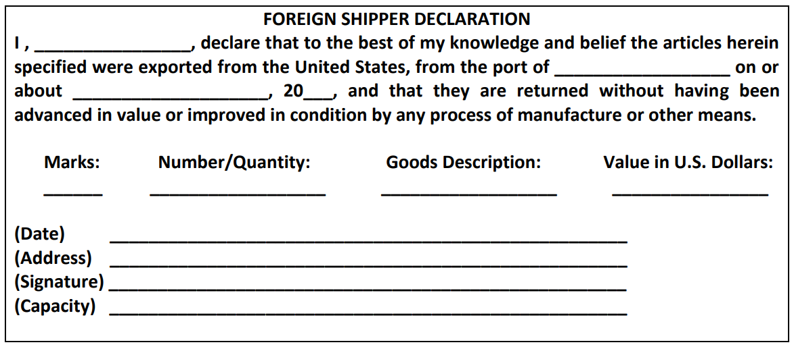
Foreign Shipper Declaration
The declaration by the foreign shipper should be in substantially the following form:

Slide 8
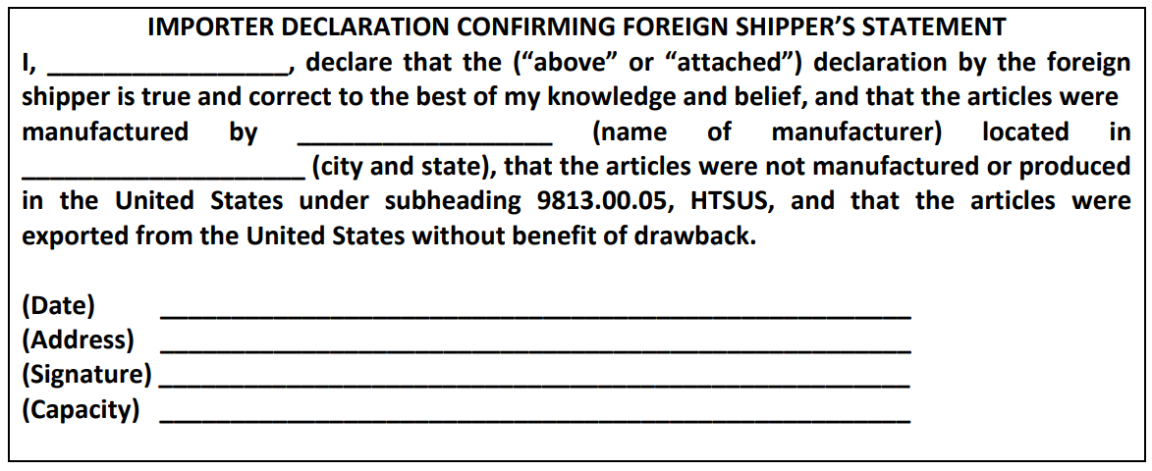
Importer Declaration Confirming Foreign Shipper’s Statement
The declaration by the owner, importer, consignee, or agent should be in substantially the following form:

Slide 9
Shipper and Importer Declarations, continued
If the owner or ultimate consignee is a corporation, the declaration may be signed by the president, vice president, secretary, or treasurer of the corporation, or may be signed by any employee or agent of the corporation who holds a power of attorney and a certification by the corporation that such employee or other agent has or will have knowledge of the pertinent facts.

Slide 10
Additional documents may be required
In cases in which the value of returned articles exceeds $2,500 and articles are not clearly marked with the name and address of the U.S. manufacturer, the port director may require, in addition to the declarations required, such other documentation or evidence as may be necessary to substantiate the claim for duty-free treatment. Such other documentation or evidence may include a statement from the U.S. manufacturer verifying that the articles were made in the United States, or a U.S. export invoice, bill of lading or airway bill evidencing the U.S. origin of the articles and/or the reason for the exportation of the articles.
On the other hand, the port director may waive these documentation requirements if reasonably satisfied because of the nature of the articles or production of other evidence that satisfies the requirements of 9801.00.10. See section 19 CFR 10.1(d).

Slide 11
Informal Entry without Documentary Requirements Allowed in Certain Cases
In the case of products of the United States, when the aggregate value of the shipment does not exceed $10,000 and the products are imported: (1) for the purposes of repair or alteration, prior to re-exportation; or 2) the articles are being returned for credit after being rejected by the foreign purchaser, may be entered as an informal entry without the documentary requirements specified in section 19 CFR 10.1.

Slide 12
Informal Entry without Documentary Requirements Allowed in Certain Cases (cont’d)
In 19 CFR 10.1(j), it specifically states that if the goods meet one of the above criteria, “free entry thereof may be made under subheading 9801.00.10, HTSUS, on CBP Form 3311, or its electronic equivalent, (a CBP Form 7501, or its electronic equivalent, must be submitted as well for such articles as provided in § 143.23(h) of this chapter), executed by the owner, importer, consignee, or agent and filed in duplicate, without regard to the requirement of filing the documentation provided for in paragraph (a) of this section, unless the CBP officer has reason to believe that CBP drawback or exemption from internal revenue tax, or both, were probably allowed on exportation of the articles or that they are otherwise subject to duty.”

Slide 13
Informal Entry without Documentary Requirements Allowed in Certain Cases (cont’d)
“The person making entry must show on CBP Form 3311, or its electronic equivalent, the name of the importing conveyance, the date of its arrival, the name of the country from which the articles were returned to the United States, and the value of the articles. The person making entry must also produce evidence of his right to make entry (except as provided in § 141.11(b) of this chapter). If the CBP officer is not entirely certain that the articles to be entered under this paragraph by a nominal consignee are products of the United States, the actual owner or ultimate consignee thereof may be required to execute a CBP Form 3311, or its electronic equivalent.”

Slide 14
Usual coverings or containers
Per 19 CFR 10.1(e), “No evidence relative to the conditions of subheading 9801.00.10, HTSUS, will be required in the case of articles that are the product of the United States and in use at the time of importation as usual coverings or containers of merchandise not subject to an ad valorem rate of duty unless such articles would be dutiable if not products of the United States under General Rule of Interpretation 5, HTSUS.

Slide 15
Aircraft and aircraft parts and equipment
Per 19 CFR 10.1 (g), in the case of aircraft and aircraft parts and equipment returned to the United States under subheading 9801.00.10, HTSUS, by or for the account of an aircraft owner or operator and intended for use in his own aircraft operations, within or outside the United States, the entry summary may be made on CF 3311, or its electronic equivalent. The entry summary on CF 3311, or its electronic equivalent, shall be executed by the entrant and supported by the entry documentation required by 19 CFR 142.3 of this chapter. If the Customs officer is satisfied that the articles are products of the United States, that they have not been improved in condition or advanced in value while abroad, and that no drawback has been or will be paid, the other documents described in 19 CFR 10.1 shall not be required, and no bond is required.

Slide 16
Shipment Value under $250
Per CFR 10.1 (i), when the total value of articles of claimed U.S. origin contained in any shipment does not exceed $250 and such articles are found to be unquestionably products of the United States and do not appear to have been advanced in value or improved in condition while abroad and no quota is involved, free entry thereof may be made under subheading 9801.00.10 on CF 3311, or its electronic equivalent, executed by the owner, importer, consignee, or agent and filed in duplicate, without regard to the requirement of filing the documentation provided for in section 19 CFR 10.1(a), unless the CBP officer has reason to believe that Customs drawback or exemption from internal revenue tax, or both, were probably allowed.

Slide 17
Articles admitted free of duty even though exported from U.S. with benefit of drawback
Per 19 CFR 10.3 (c), the following articles shall be admitted free of duty, even though exported from the United States with benefit of drawback:
(1) Any article of a kind which would be admitted free of duty otherwise than under Chapter 98, Subchapter 1, HTSUS, if of foreign origin;
(2) Substantial containers or holders of domestic manufacture, including shooks and staves when returned as boxes or barrels, when in use at the time of importation as the usual containers of merchandise;
(3) Any article provided for in subheadings 9801.00.70 or 9801.00.80, HTSUS, with respect to which the port director has determined that the collection of duty under such subheadings 9801.00.70 or 9801.00.80, HTSUS, would involve an expense and inconvenience to the Government disproportionate to the probable amount of such duty; and
(4) Other articles of domestic manufacture which are in use at the time of importation as the usual coverings or containers of merchandise not subject to an ad valorem rate of duty, and which have not been advanced in value or improved in condition while abroad by any process of manufacture or other means.

Slide 18
Article Manufactured in Bonded Warehouse
Per 19 CFR 10.3(d) Articles manufactured or produced in the United States in a Customs bonded warehouse and exported shall be subject on re-importation to a duty equal to the total duty and internal-revenue tax, if any, imposed at the time of entry for consumption or withdrawal from warehouse for consumption with respect to the importation of like articles not previously exported from the United States.

Slide 19
Lesson 2: 9801.00.25, Returned Goods Not Conforming to Samples or Specifications
The principal difference between 9801.00.10 and 9801.00.25 is that goods of 9801.00.25 are returned goods not conforming to original samples or specifications. In addition to the requirement that goods entered under subheading 9801.00.25 HTSUS were previously entered duty-paid, removed from Customs custody, and subsequently exported, there are four provisions listed in the tariff article description, which reads as follows:

Slide 20
9801.00.25, Returned Goods Not Conforming to Samples or Specifications – 4 Provisions
Articles, previously imported, with respect to which the duty was paid upon such previous importation if
exported within three years after the date of such previous importation,
(2) reimported without having been advanced in value or improved in condition by any process of manufacture or other means while abroad,
(3) reimported for the reason that such articles do not conform to sample or specifications, and
(4) reimported by or for the account of the person who imported them into, and exported them from, the United States.

Slide 21
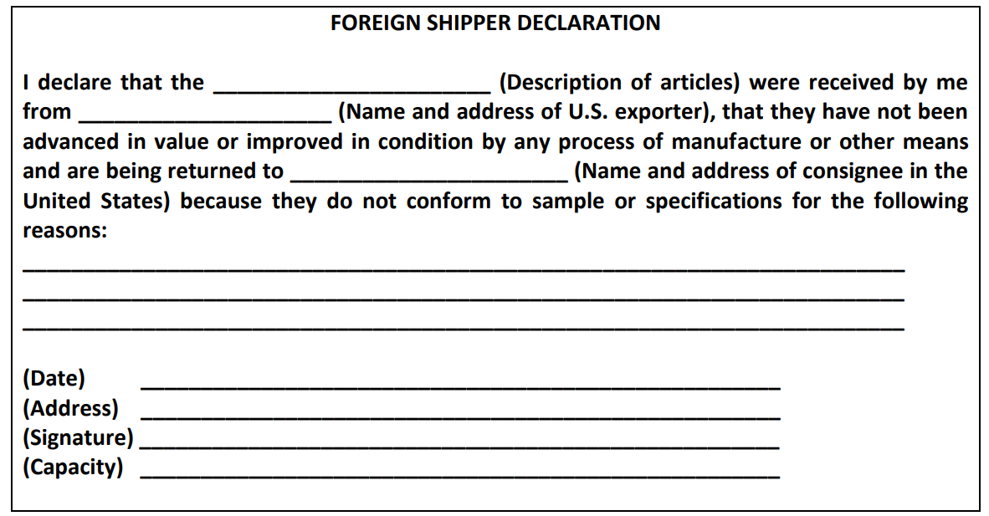
Documents Required – Foreign Shipper Declaration
Per 19 CFR 10.8a (b), two supplementary documents are usually required in connection with duty free entries under subheading 9801.00.25, HTSUS. A declaration shall be filed by the person abroad who received and is returning the merchandise to the United States in substantially the following form:

Slide 22
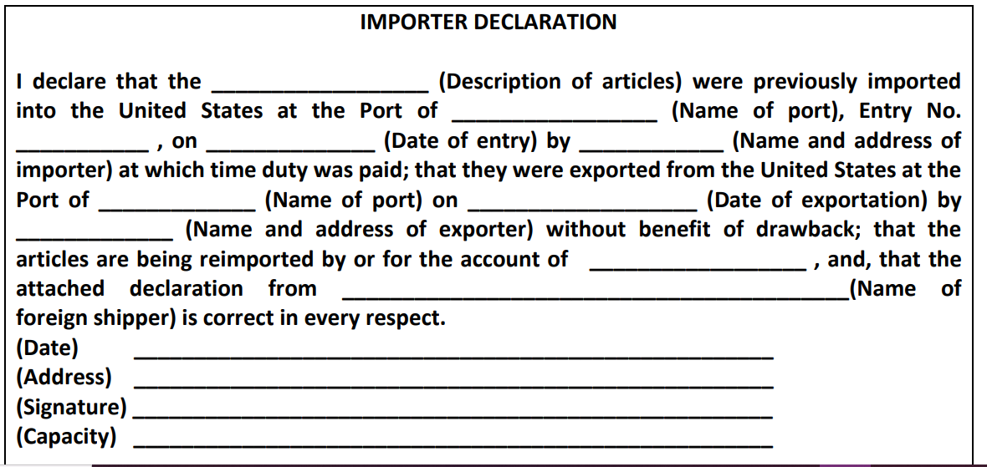
Document Required – Importer Declaration
In addition, a declaration shall be filed by the owner, importer, consignee, or agent, in substantially the following form:

Slide 23
Document requirement may be waived
If the port director concerned is reasonably satisfied because of the nature of the articles or production of other evidence that the requirements of subheading 9801.00.25, and the related section notes and additional U.S. notes from the HTSUS have been met, he may waive the production of the above declarations.

Slide 24
Lesson 3: 9802.00.40 and 9802.00.50, Goods Exported and Return after Repairs or Alterations
Subheading 9802.00.40 provides for the return of goods that have been exported from the United States and that were repaired or altered under warranty, and returned to the United States without having been advanced in value or improved in condition by any process of manufacture or other means. Whereas, subheading 9802.00.50, is identical to 9802.00.40 except that the repair or alterations are not performed under warranty. Refer to Regulations governing subheadings, 9802.00.40 and 9802.00.50, HTSUS, are in 19 CFR Part 10.8 “Articles exported for repairs or alterations” (a) through (d).

Slide 25
9802.00.40 and 9802.00.50, Goods Exported and Return after Repairs or Alterations (cont’d)
Any of the following conditions preclude the use of 9802.00.40 and 9802.00.50:
• The importer fails to identify the articles as being previously exported.
• The foreign operations caused the identity or HTSUS classification of the exported article to change.
• The foreign operations were limited to minor procedures, such as warehousing, repackaging, sorting, and testing not performed in conjunction with repairs or alterations.
• The exported articles were incomplete for their intended use prior to being exported and the foreign operation constitutes an intermediate processing operation.
• Drawback has been claimed on the exported articles.

Slide 26
Duty is assessed on Value of Repairs or Alterations
For goods that qualify for entry under the terms of 9802.00.40 or 9802.00.50, the exported U.S. articles are entered duty-free while the remaining value, that is, the repair value, of the article is entered under the duty rate associated with the tariff classification of the imported article. However, in some cases, such as special tariff agreements, such as NAFTA, the entire item may enter duty-free.

Slide 27
Duty is assessed on Value of Repairs or Alterations (cont’d)
Per HTSUS Chapter 98 Subchapter II, U.S. Note 3, the value of repairs, alterations, processing or other change in condition outside the United States shall be: i. The cost to the importer of such change; or ii. If no charge is made, the value of such change, as set out in the invoice and entry papers; except that, if the appraiser concludes that the amount so set out does not represent a reasonable cost or value, then the value of the change shall be determined in accordance with section 402 of the Tariff Act of 1930, as amended.

Slide 28
Value limitations
The cost or value of the repairs or alterations outside the United States, shall be limited to the cost or value of the repairs or alterations actually performed abroad, which will include all domestic and foreign articles furnished for the repairs or alterations but shall not include any of the expenses incurred in this country whether by way of engineering costs, preparation of plans or specifications, furnishing of tools or equipment for doing the repairs or alterations abroad, or otherwise.. Refer to 19 CFR 10.8 (d).

Slide 29
Fungible Items and Inventory Control
Per HTSUS Chapter 98 Subchapter II, U.S. Note 3 (f), for purposes of subheadings 9802.00.40 and 9802.00.50, fungible articles exported from the United States (A) may be commingled; and (B) the origin, value, and classification of such articles may be accounted for using an inventory management method.
If a person chooses to use an inventory management method with respect to fungible articles, the person shall use the same inventory management method for any other articles with respect to which the person claims fungibility. The term 'fungible articles' means merchandise or articles that, for commercial purposes, are identical or interchangeable in all situations; and the term 'inventory management method' means any method for managing inventory that is based on generally accepted accounting principles.

Slide 30
Documents Required
There are two documents required for the entry of articles which are returned after having been exported for repairs or alterations and which are claimed to be subject to duty only on the value of the repairs or alterations performed abroad. The first one is a declaration from the person who performed the repairs or the alteration must be provided.
An example follows:

Slide 31
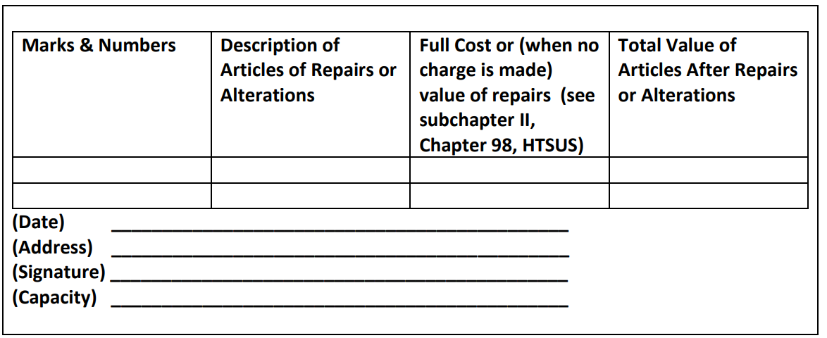
Documents required (cont’d)

Slide 32
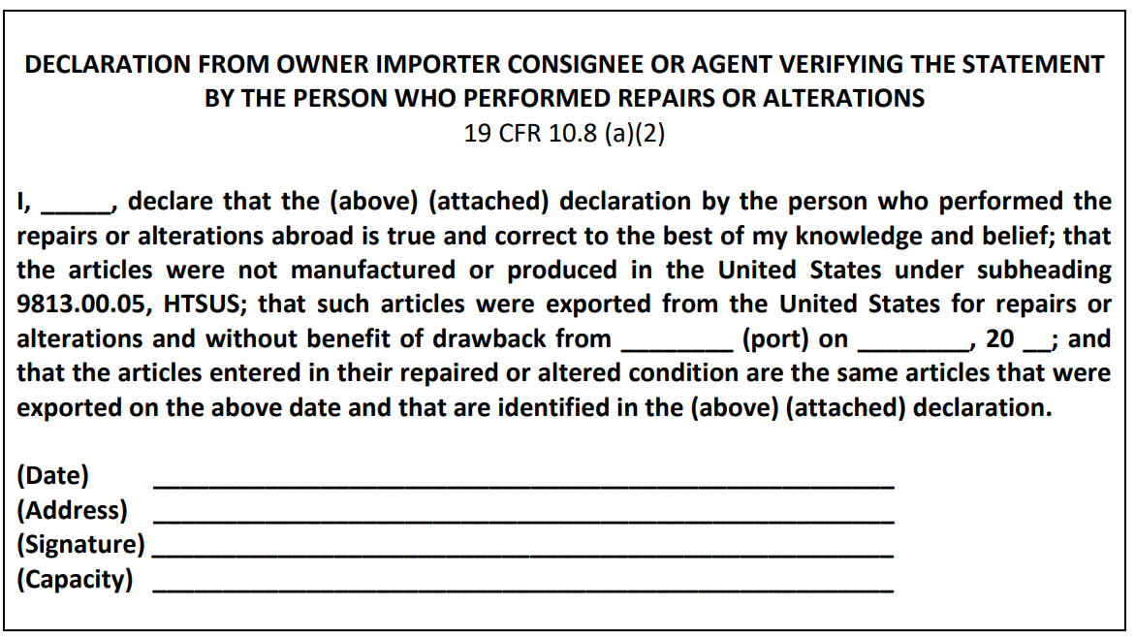
Documents required (cont’d)
The second required document is a declaration by the owner, importer, consignee or agent having knowledge of the pertinent facts also must be made. The following is a suggested format:

Slide 33
Lesson 4: 9802.00.80, Imported Goods Assembled from U.S. Components
This lesson discusses the partial duty exemption provided by subheading 9802.00.80, which is applicable to imported articles which have been assembled abroad from fabricated components that are a product of the United States. Exceptions include certain goods imported under special programs for products assembled in sub-Saharan Africa or the Caribbean Basin, that grant duty-free treatment when special terms are met. Goods entered under 9802.00.80 are subject to duty on their full value less the cost or value of their U.S. components. See sections 19 CFR 10.11 through 10.23, under the heading, “Articles Assembled Abroad with United States Components.”

Slide 34
9802.00.80, Imported Goods Assembled from U.S. Components (cont’d)
Articles entered under subheading 9802.00.80, must meet the following three requirements:
Were exported in condition ready for assembly without further fabrication;
2. Have not lost their physical identity in such articles by change in form, shape or otherwise; and
3. Have not been advanced in value or improved in condition abroad except by being assembled and except by operations incidental to the assembly process such as cleaning, lubricating and painting.

Slide 35
Definition of Assembly Operations
CBP has a narrow definition of “assembly operations” allowed while abroad. This definition includes fitting or joining together of fabricated components by any method such as: soldering, welding, gluing, sewing, the use of fasteners, and laminating. The mixing of gases, liquids, chemicals, food ingredients, or amorphous solids, either with each other or with other solid components, is not considered an assembly operation. (See 19 CFR 10.16 (a)).

Slide 36
Requirements and Procedures for 9802.00.80
“Exported in condition ready for assembly without further fabrication” excludes materials that are exported in an undefined shape or dimension such as lumber, sheet metal or bolts or rolls of fabric - such goods are not considered to be “fabricated” components. Furthermore, any such fabricated components must be the product of the United States. This does not automatically exclude foreign goods imported into the United States, provided they undergo sufficient processing in the United States to result in the substantial transformation of the imported materials. Substantial transformation occurs when as a result of manufacturing processes; a new and different article emerges, having a distinctive name, character, or use, which is different from that originally possessed by the article or material before being subject to the manufacturing process (See 19 CFR 10.14).

Slide 37
Excluded Components
The duty reduced valuation allowance allowed under 9802.00.80 will not be granted if the fabricated components:
• Were in continuous customs custody with remission, abatement or refund of duty;
• Benefited from a duty drawback;
• Did not comply with the law of the United States, or regulation of any Federal agency regarding their exportation; or
• Were manufactured or produced in the United States under subheading 9813.00.05 (articles admitted temporarily under bond for repair, alteration, or processing, including processes that result in articles manufactured or produced in the United States).

Slide 38
Acceptable Assembly Operations
It is important that assembly operations performed abroad do not exceed the strict criteria provided by subheading 9802.00.80. If these criteria are exceeded beyond what is considered to be acceptable assembly operations (other than “operations incidental to the assembly process”), the fabricated components will not be eligible to receive preferential treatment. Acceptable assembly operations may consist of any method used to join or fit together solid components (e.g., welding, soldering, riveting, force fitting, gluing, laminating, sewing, or the use of fasteners). The mixing or combining of liquids, gases, chemicals, food ingredients, and amorphous solids, either with each other or with solid components, is not regarded as an assembly process.

Slide 39
Operations “incidental” to the assembly process
Operations “incidental” to the assembly process are as follows:
• Cleaning
• The removal of rust, grease, paint or preservative coating
• The application of preservative paint or coating, including preservative metallic coating, lubricants, or protective encapsulation
• Trimming, filing or removing of small amounts of excess material
• Adjustments in the shape or form of a component to the extent required by the assembly being performed abroad
• The final calibration, testing, marking, sorting, and pressing of assembled articles
• Cutting length of wire, thread, tape, foil, and similar products exported in continuous length; separation by cutting of finished components, such as prestamped integrated circuit lead frames exported in multiple unit strip

Slide 40
Operations “not incidental” to the assembly process
Any significant process, operation, or treatment other than assembly whose primary purpose is the fabrication, completion, physical or chemical improvement of a component, or which is not related to the assembly process, whether or not it effects a substantial transformation of the article, shall not be regarded as incidental to the assembly and shall preclude the application of the exemption to such article. Per 19 CFR 10.16 (c), the following are examples of operations not considered incidental to the assembly as provided under subheading 9802.00.80, HTSUS (19 USC 1202):

Slide 41
Operations “not incidental” to the assembly process (cont’d)
Melting of exported ingots and pouring of the metal into molds to produce cast metal parts;
• Cutting of garment parts according to pattern from exported material;
• Painting primarily intended to enhance the appearance of an article or to impart distinctive features or characteristics;
• Chemical treatment of components or assembled articles to impart new characteristics, such as showerproofing, permapressing, sanforizing, dying or bleaching of textiles; and
• Machining polishing, burnishing, peening, plating (other than plating incidental to the assembly), embossing, pressing, stamping, extruding, drawing, annealing, tempering, case hardening, and
• Any other operation, treatment or process which imparts significant new characteristics or qualities to the article affected.

Slide 42
Joining of American-made and foreign-made components
An assembly operation may involve the use of American-made components and foreign-made components. The various requirements for establishing entitlement to the exemption apply only to the American-made components of the assembly.

Slide 43
Country of origin marking
Goods imported under 9802.00.80 are subject to the requirements of the country of origin marking statute, section 304, Tariff Act of 1930, as amended (19 USC 1304). This statute requires an article of foreign origin (or its container) imported into the United States to be marked with the English name of the country of origin of the article, as legibly, indelibly and permanently as the nature of the article (or container) will permit. The country of origin of an article is the country of manufacture, production or growth of the article. If further work or material added to an article in another country constitutes a substantial transformation – that is, a new article with a different name, character and use is created – then that country will be determined to be the country of origin of the article. In general, a complex assembly of many parts will constitute a substantial transformation. By contrast, a simple assembly will generally not constitute a substantial transformation. A complex assembly is the same as a non-incidental operation, and a simple assembly is the same as an incidental assembly operation.

Slide 44
Documents required
In accordance with 19 CFR 10.24, a Foreign Assembler's Declaration must be made in connection with the entry of assembled articles under subheading 9802.00.80, HTSUS. The declaration is made by the person who performed the assembly operations abroad and it includes an endorsement by the importer.
U.S. Customs regulations 19 CFR 10.24(c) and (d) require that the importer/assembler maintain records for 5 years from the date of the related entry and that they make these records readily available to CBP for audit, inspection, copying, and reproduction.
An example follows:

Slide 45
Documents required (cont’d)

Slide 46
Valuation of Imported Goods Assembled from U.S. Components
Many importers have the misconception that duty under 9802.00.80 is based upon the “value added” abroad. Instead, the law requires that the appraised value of the merchandise be determined first; only then is an allowance made for the cost or value of those componentswhich are products of the United States that meet all the requirements of subheading 9802.00.80. As in the case of the appraisement of any other import merchandise, the value for duty of the imported goods assembled from U. S. components is calculated in accordance with the transaction value methodology. Then, in accordance with the provisions of 9802.00.80, the value of the U. S. manufactured and qualifying “fabricated components” is deducted from the full transaction value of the imported goods.
The value of the “fabricated U.S. components” is based upon the cost or value of each component, Free On Board (FOB) the U.S. port of exportation. This FOB value should include the purchase price or, if not purchased, the cost to acquire or manufacture the components and the costs of freight and insurance incurred up to the time of the components’ arrival at the port of exportation.

Slide 47
9802.00.80 Entry Requirements
The entry requirements for goods entered under the provisions of 9802.00.80 are generally the same as those for all imported merchandise. Additionally, for transactions for which preferential tariff treatment under 9802.00.80 is claimed, there must be filed, in accordance with section 10.24, Customs Regulations (19 CFR 24): 1) a Declaration by the Assembler, and 2) an Endorsement by the Importer.
Normally, if the pertinent data (i.e., assembly description, list of U.S. components, their unit costs, etc.) is on file at the appropriate CBP office, entry may be made by referring to this information. However, specific cost data or other necessary information may be required with each entry depending upon the procedure agreed to by the importer and the CBP import specialist.

Slide 48
Repairs and Alterations Under 9802.00.40 and 50
Subheading 9802.00.40 provides for the return of goods that have been exported from the United States and that were repaired or altered under warranty, and returned to the United States without having been advanced in value or improved in condition by any process of manufacture or other means. Other repairs or alterations, subheading 9802.00.50, are identical to 9802.00.40 except that the repair or alterations are not performed under warranty.

Slide 49
Any of the following conditions preclude the use of 9802.00.40 and 9802.00.50:
• The importer fails to identify the articles as being previously exported.
• The foreign operations caused the identity or HTSUS classification of the exported article to change.
• The foreign operations were limited to minor procedures, such as warehousing, repackaging, sorting, and testing not performed in conjunction with repairs or alterations.
• The exported articles were incomplete for their intended use prior to being exported and the foreign operation constitutes an intermediate processing operation.
• Drawback has been claimed on the exported articles.” (Focused Assessment Program, 2003)

Slide 50
Repair and Alterations Cont’d
For goods that qualify for entry under the terms of 9802.00.40 or 9802.00.50, the exported U.S. articles are entered duty-free while the remaining value, that is, the repair value, of the article is entered under the duty rate associated with the tariff classification of the imported article. However, in some cases, such as special tariff agreements, the entire item may enter duty-free. When goods are returned to the U.S., duty is only paid on the cost of improvements made while out of the country.

Slide 51
Repair and Alterations Cont’d
In order for goods to qualify for entry under the conditions of 9802.00.40 or 9802.00.50, the same conditions required for subheading 9802.00.80 apply. The operations that may take place without disqualifying goods from entry under 9802.00.40 and 9802.00.50 are considered "incidental" or "minor" operations, the list of these operations are listed in "Operations That are Considered Incidental" of the previous Lesson 2, Topic 1.

Slide 52
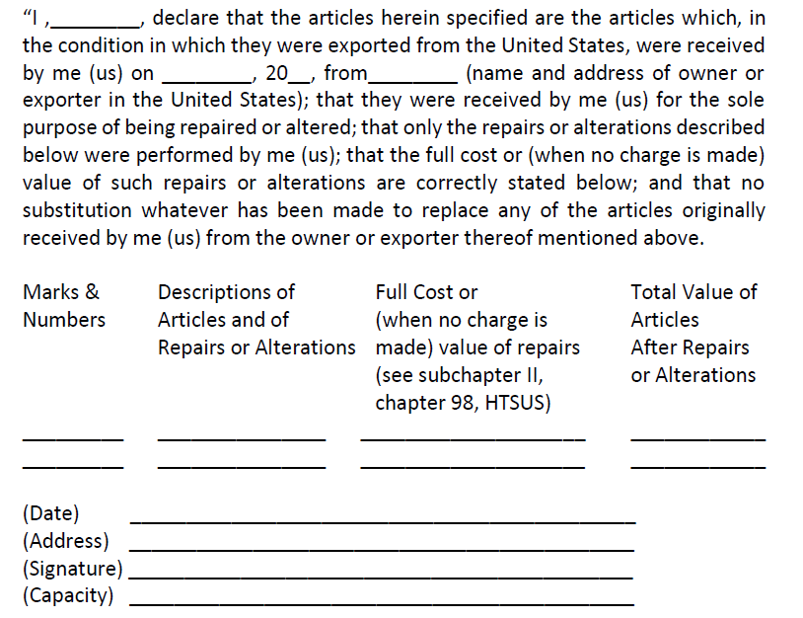
Declaration by the Person Performing the Repair or Alteration
When goods are returned to the United States, a declaration from the person who performed the repairs or the alteration must be provided. An example follows:

Slide 53
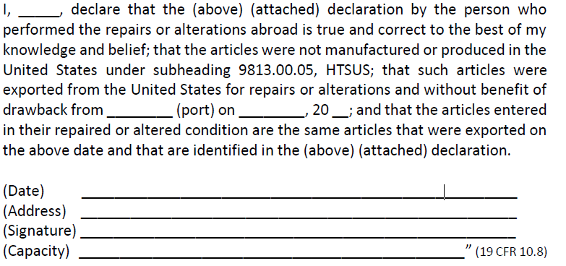
Importer's Declaration
A declaration by the owner, importer, consignee or agent having knowledge of the pertinent facts also must be made. The following is a suggested format:

Slide 54
Examples
#1
Example: A cement mixer is made in Germany. The U.S. importer decides he needs a larger motor to work with a certain type of cement so he arranges to ship the mixer back to Germany to have the new motor installed. When the mixer is returned to the U.S., the importer is only responsible to pay duty on the cost of the alterations.
Repairs or alterations means:
Restoration
Addition
Renovation
Re-dyeing
Cleaning
Re-sterilizing
Any other treatment that preserves the essential characteristics of the exported good, except processing on an incomplete or unfinished article.

Slide 55
Examples
#2
Example: Unflanged metal wheel rims are exported to Canada for a flanging operation to strengthen them to conform to U.S. Army specifications for wheel rims. Although the goods when exported from the United States are dedicated for use in the making of wheel rims, they cannot be used for that purpose until flanged. The flanging operation does not constitute a repair or alteration because that operation is necessary for the completion of the wheel rims.
Processing that results in a new, commercially-different good is not considered a repair or alteration.

Slide 56
Examples
#3
Example: Glass mugs produced in the United States are exported to Canada for etching and tempering operations, after which they are returned to the United States for sale. The foreign operations exceed the scope of an alteration because they are manufacturing processes which create commercially different products with distinct new characteristics.

Slide 57
References
9801.00.10. (2020). Harmonized Tariff Schedule of the United States, Revision 16.
9802.00.80. (2020). Harmonized Tariff Schedule of the United States, Revision 16.
Articles exported for repairs or alterations. (2020). Retrieved from 19 CFR 10.8.
Assembly Abroad. (2020). 19 CFR 10.16.
Documentation. (2020). 19 CFR 10.24.
Domestic products; requirements on entry. (2020). 19 CFR 10.1.
Fabricated components not subject to the exemption. (2020). 19 CFR 10.15.
Focused Assessment Program. (2003, October). Retrieved from U.S. Customs and Border Protection Office of Strategic Trade Regulatory Audit Division: http://www.gistnet.com/library/2/exhibits/FocusedAssessmentProgram10-2003.pdf
Foreign Assembly of U.S. Components. (2006, April). Retrieved from An Informed Compliance Publication: https://www.cbp.gov/document/guidance/foreign-assembly-us-components
Statutory provision: Subheading 9802.00.80 HTSUS (19 USC 1202). (2020). 19 CFR 10.13.

