Slide 1
CROSS BORDER LOGISTICS
COURIER
FREIGHT FORWARDING
CUSTOMS BROKERAGE
Presented by
Tel: 204-784-4800
Email: sales@frontierscs.com

Slide 2
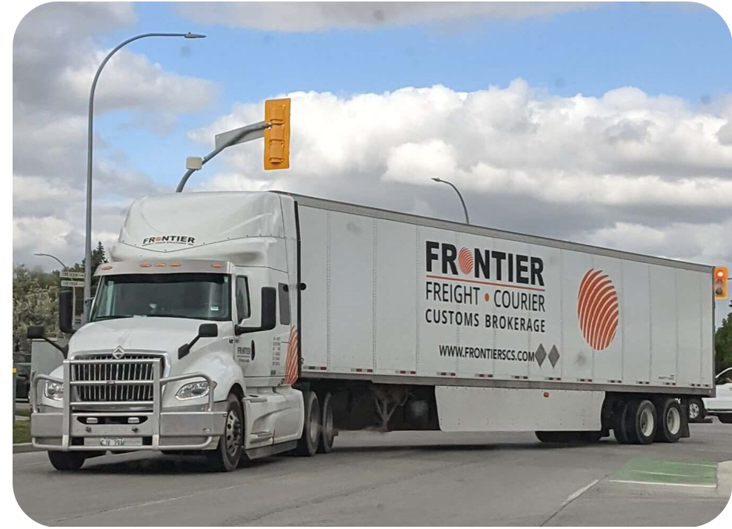
ABOUT FRONTIER
A LEADING PROVIDER OF LOGISTICS & CUSTOMS BROKERAGE SERVICES
Frontier Supply Chain Solutions Inc. is a full-service provider of Cross border Logistics,
US & Canadian customs brokerage, Freight Forwarding and Courier services.
By combining our strengths in these three fields, Frontier can create comprehensive North American supply chain solutions for businesses of all sizes and industries.

Slide 3
FRONTIER SERVICES
CROSSBORDER LOGISTICS
CANADIAN CUSTOMS BROKERAGE
USA CUSTOMS BROKERAGE
INTERNATIONAL FORWARDING
FREIGHT & COURIER
TRADE COMPLIANCE

Slide 4
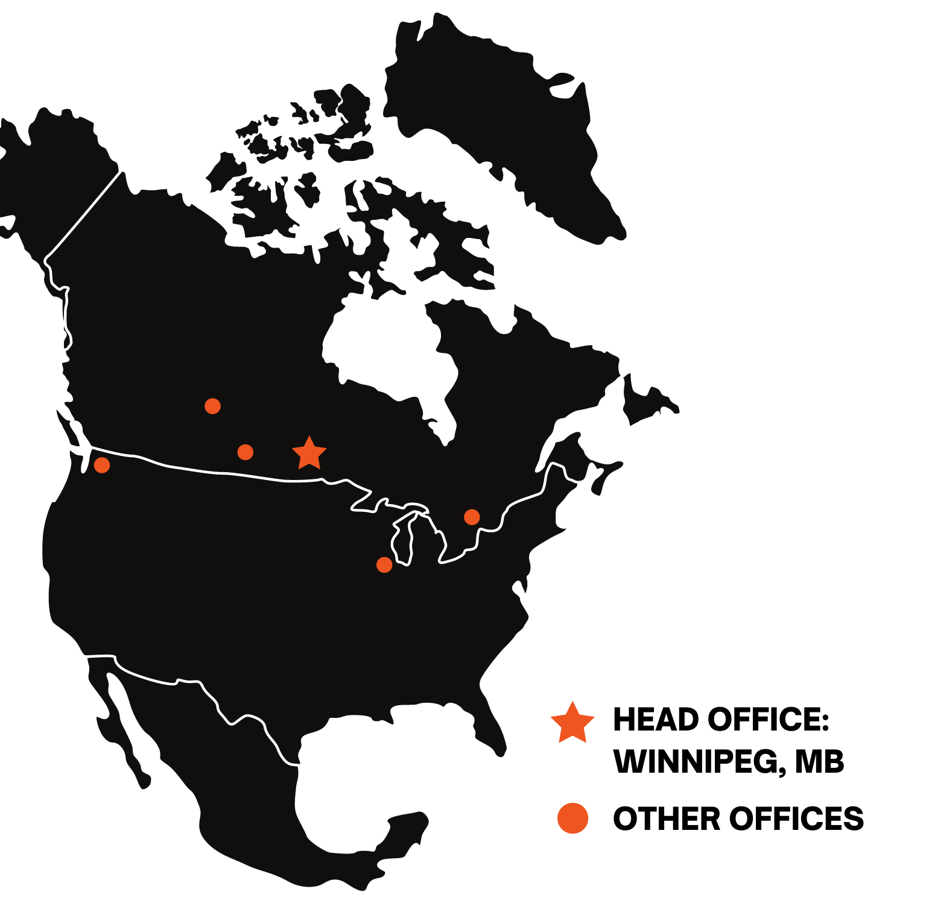
FRONTIER OFFICES
WHO ARE WE?
With offices throughout North America, Frontier employs over 250 individuals across the region.
LOCATIONS
CANADA:
Winnipeg, MB
Toronto, ON
Regina, SK
Saskatoon, SK
Chicago, IL
Seattle, WA
USA:

Slide 5
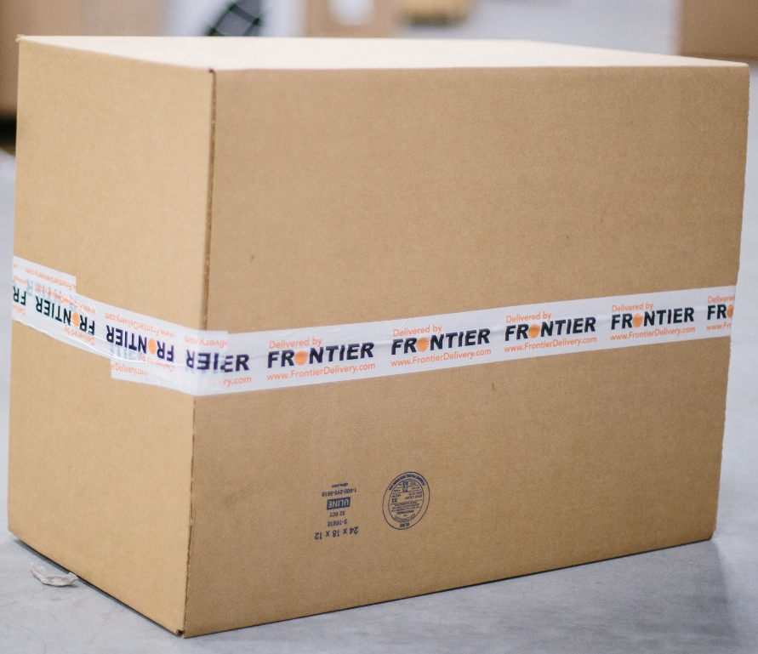
CANADIAN CUSTOMS BROKERAGE
STREAMLINING CUSTOMS PROCESS
Frontier is supported by a team of seasoned professionals who specialize in simplifying your international trade.
FEATURES:
Guide you through the intricacies of cross-border trade in the Canadian local and global markets.
Avoid delays at the border with our brokers with accurate tariff classification
Experience seamless customs clearance, compliance, and duty optimization to elevate the efficiency of your supply chain.

Slide 6
USA CUSTOMS BROKERAGE
FRONTIER NORTH AMERICA
We are your premier partner for seamless international trade solutions, specializing in US customs brokerage.
FEATURES:
Web Tracker offers an access detailed information about the shipment’s location, expected delivery date etc.
With our nationwide network, Frontier is your reliable broker for international shipments.
With “one client – one team” approach, we become familiar with client products to clear goods faster and remove border delays.

Slide 7
TRADE COMPLIANCE
ELEVATE YOUR BUSINESS
Frontier Trade Consulting delivers specialized insights and tailor-made solutions to drive your success in the ever-evolving trade landscape.
FEATURES:
Our experienced consultants collaborate closely with you to realize your objectives and secure a distinct competitive advantage.
Trusted partners in making informed decisions that drive growth and navigate complexities.

Slide 8
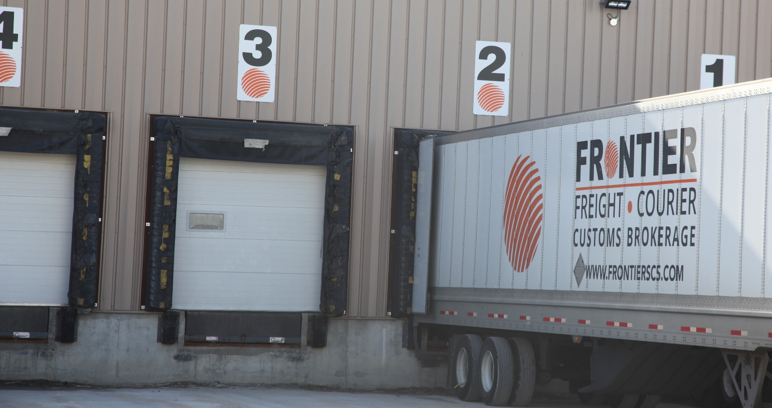
CROSSBORDER LOGISTICS
PARCEL & LTL FREIGHT
Shipping parcel and LTL freight into Canada has never been easier than using our crossborder services.
FEATURES:
Crossborder hubs of Winnipeg, Mb, Chicago IL, & Toronto, ON. This Triangle creates the fastest delivery from the U.S. Midwest to Canada.
Ensure secure and prompt deliveries with cutting-edge tracking technologies and a robust network,

Slide 9
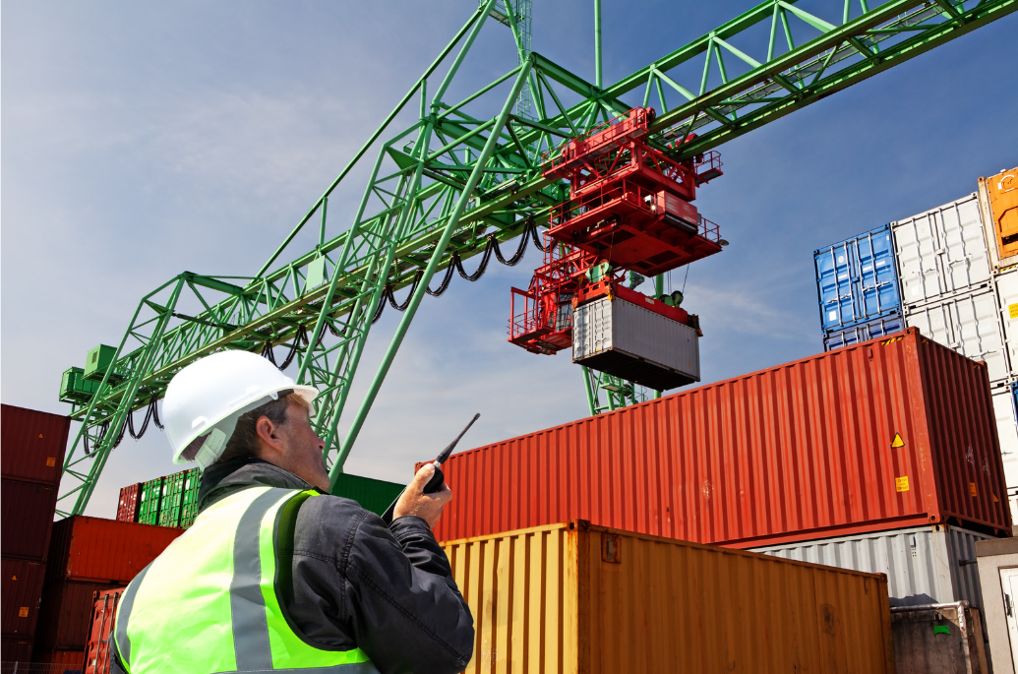
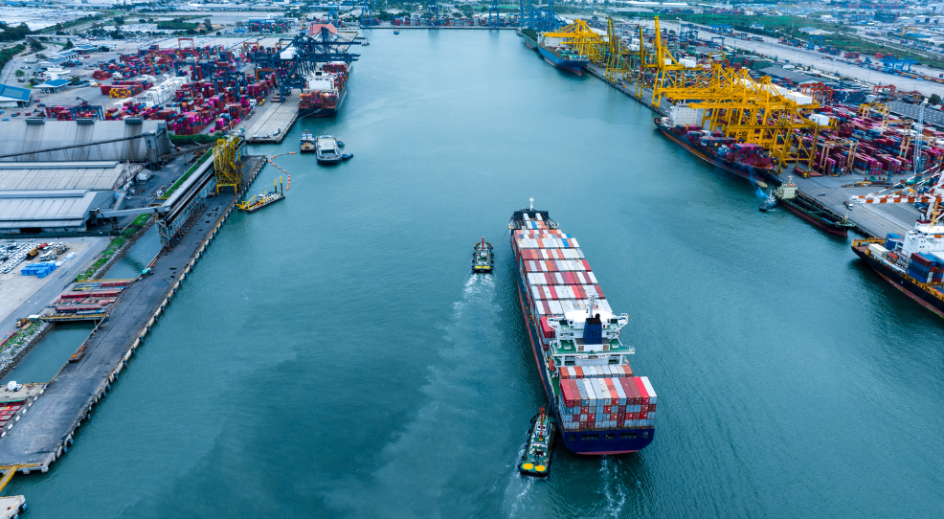
INTERNATIONAL FREIGHT FORWARDING
PROVIDE CONTROL AND VISIBILITY
Use Frontier`s online solutions to provide control and visibility throughout the entire exporting and importing process
FEATURES:
Experience of ocean and air freight services, ensuring your cargo reaches its destination swiftly and securely.
Offering air and sea, freight, we have a global partner network to give you options and ensure your cargo is in capable hands.
Our customs brokers ensure required document preparation and accurate tariff classification to avoid unexpected penalties.

Slide 10
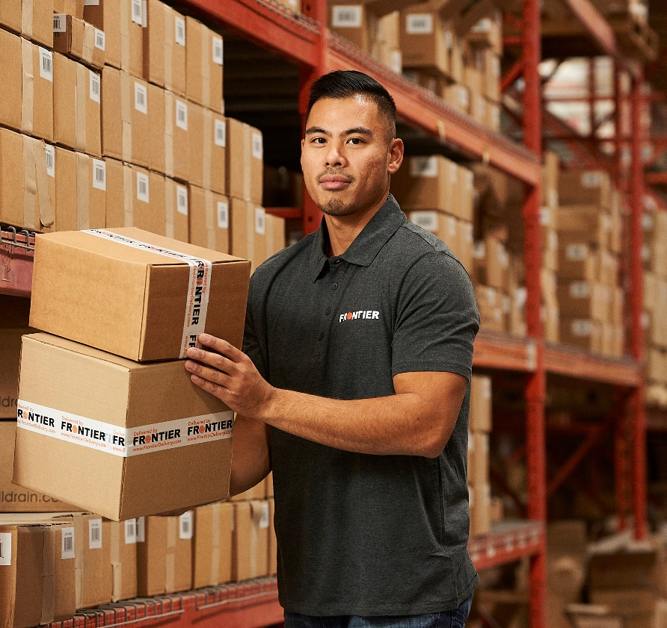
FREIGHT & COURIER
LTL & PARCEL DELIVERY
We provide last mile LTL & parcel delivery throughout Canada. With a combination of fixed assets & partners, Frontier delivers to over 800,000 Canadian postal codes for home delivery.
FEATURES:
Combine multiple shipments into a single load to optimizes space and increase operational efficiencies.
Use tracking technologies with detailed reports.
Cut down on shipping costs while maintaining reliable delivery services.

Slide 11
EXPERT EXPERIENCE
Headquartered in Winnipeg, Canada, Frontier is dedicated to working with businesses to save them money by creating dependable solutions for today and the future. We pride ourselves on knowing all our customers on a personal level and working with them to create simple, customized solutions delivered by experts.
SPECIALIZED SOLUTIONS
With strategically located facilities in Winnipeg, Toronto, Chicago, and Seattle, we specialize in providing customized solutions that grow with your business. We tailor our strategies and services to fit your budget and business needs. With all our warehouses, cross-docking facilities and operations located in one building, we always ensure simple and efficient service to you and your market.
ONE CLIENT – ONE TEAM APPROACH
Our one-on-one customer service focus ensures your business is supported by a team of experienced individuals that know your products and how to keep your supply chain moving freely.

