Slide 1
NON-RESIDENT
IMPORTER PROGRAM
Presented by

Slide 2
OUR SERVICES
FRONTIER WORKS WITH COMPANIES IN NORTH AMERICA TO IMPROVE THEIR CROSS-BORDER TRADE:
TRANS-BORDER LOGISTICS
CANADIAN CUSTOMS BROKERAGE
INTERNATIONAL FORWARDING
US CUSTOMS BROKERAGE
TRADE COMPLIANCE
FREIGHT & COURIER

Slide 3
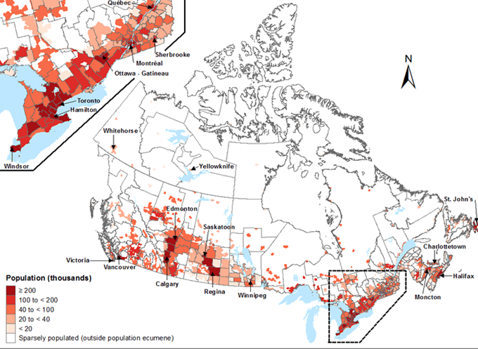
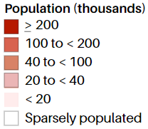
THE CANADIAN MARKET
CANADA'S POPULATION: 37,000,000 +
Live within 100 miles of the U.S. border
90%
60%
Live in Ontario & Quebec
Live in British Columbia & Alberta
25%
AVERAGE ANNUAL HOUSEHOLD INCOME: $68,000
SIMILAR DEMOGRAPHICS AS THE U.S.

Slide 4
CHALLENGES TO ENTERING CANADA
HIGH COSTS
Exchange rate fluctuations
Inefficient to maintain a second supply chain
Expensive to maintain dual inventory
Large geographic area with low population density

Slide 5
CHALLENGES FOR THE CANADIAN CONSUMER
INCOMPLETE ORDERS DUE TO POOR FILL RATES
HIGH SHIPPING COSTS
TRANSIT TIMES
CUSTOMS CLEARANCE
RETURN ORDER COMPLICATIONS
UNKNOWN IMPORT FEES
THE COST OF DEALING WITH FOREIGN CURRENCY

Slide 6
WAYS OF SELLING IN CANADA
DISTRIBUTOR MODEL
Yields less control and lower margins
MANUFACTURER’S REPRESENTATIVES
Manufacturer’s representatives
INCORPORATING IN CANADA
Investing in overhead
DIRECT
Selling direct via the NRI

Slide 7
NON-RESIDENT IMPORTER (NRI)
WHAT IS AN NRI
SEAMLESS CUSTOMS CLEARANCE
A company that operates in Canada without requiring a physical location
SIMPLIFY THE SHIPPING PROCESS
SATISFIED CANADIAN CONSUMER

Slide 8
LANDED COST
WHAT ARE LANDED COSTS?
Becoming an NRI allows the U.S. company the ability to sell to Canada on a duty delivered paid (DDP) basis. This makes the U.S. company more attractive to buy from.
BREAKDOWN:
Product Cost:
Shipping - Costs associated with crating, packing, handling, and freight
Customs - Duties, taxes, tariffs, VAT, brokers fees
Risk - Insurance, compliance, safety stock cost
Overhead - Exchange rates
LANDED COST

Slide 9
BECOMING AN NRI: CHECKLIST
VALUATION
DUTY AND DATABASES
US-MEXICO-CANADA
AGREEMENT (USMCA)
BOOKS AND RECORDS
COMPLIANCE
VALUE ADDED TAXES (GST AND HST)

Slide 10
CANADIAN RULES FOR MAINTAINING RECORDS
RESPONSIBILITIES OF THE NON-RESIDENT
Maintaining all books/records for audit by Canada revenue agency
TIMEFRAME
Maintenance for up to 6 years + current year
AUDITS
Audit able to be performed by CRA
MAINTENANCE IN USA
Audit able to be performed by CRA

Slide 11
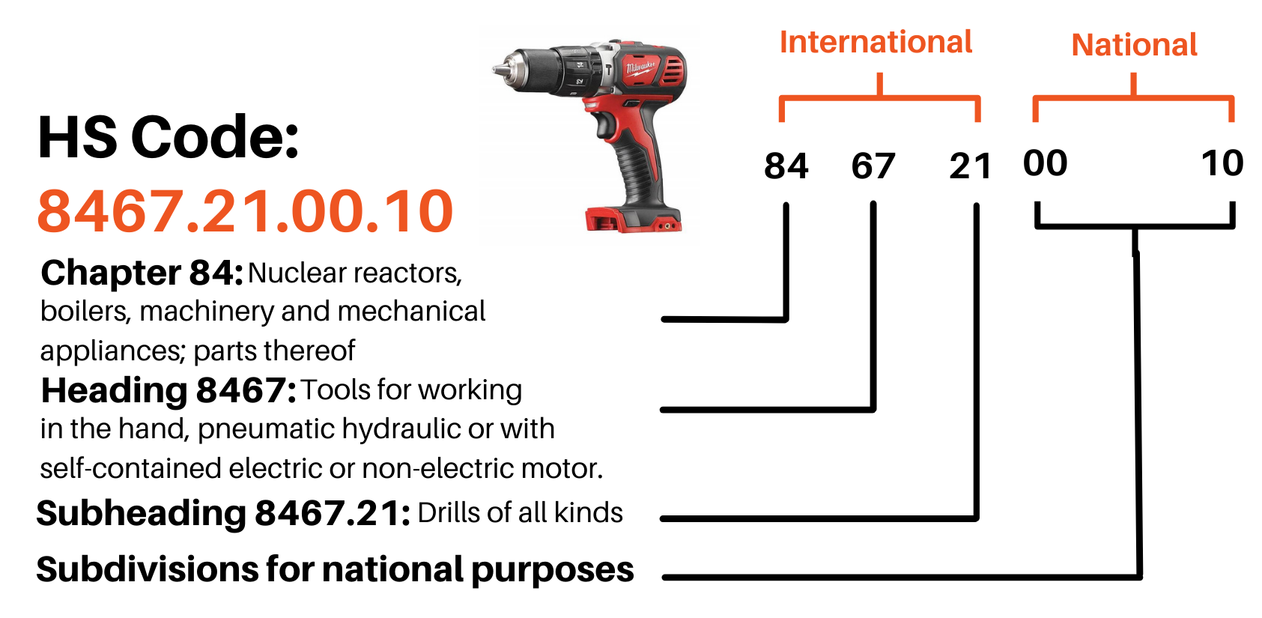
TARIFF CLASSIFICATION
THE HARMONIZED CODE (H.S)
EXAMPLE: ROTARY, BATTERY POWERED DRILL
Has 99 Chapters
Commodities get more complex as you progress

Slide 12
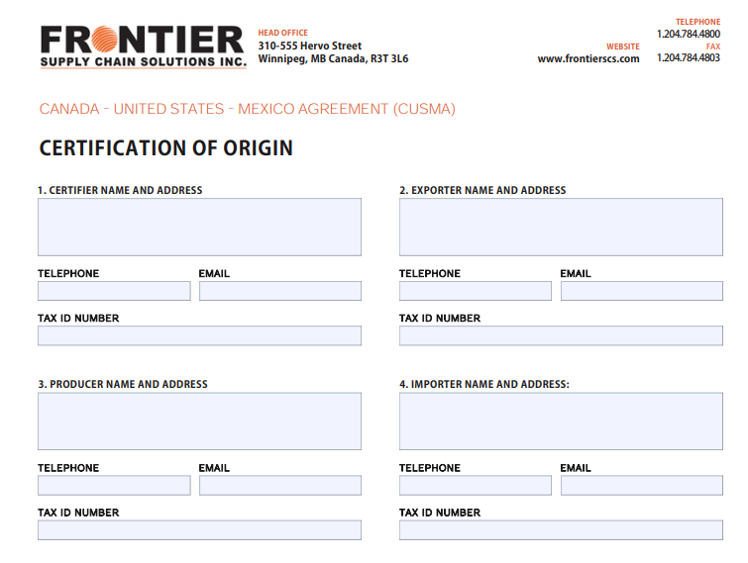
FREE TRADE AGREEMENTS
USMCA
CERTIFICATE OF ORIGIN FORM:
The trade agreement among the U.S. Mexico & Canada
To ensure your customers don't pay duty, it is important that the form is accurate and verified
IMPORTANT NOTES ON USMCA
Avoid costly duty by knowing what qualifies
Make it easy for your customers to retrieve
Ensure accuracy and constant updates and review
Internal ownership required for successful USMCA management

Slide 13
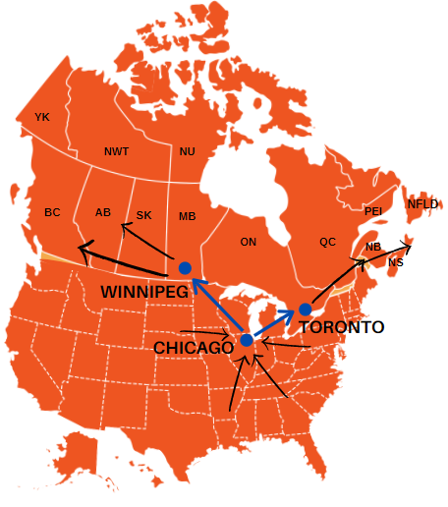
ACCESS TO CANADA
CLOSE PROXIMITY
Considering 90% of Canada's population is within 100 miles of the border – it's often more efficient to fulfill the market using U.S. inventory.

Slide 14
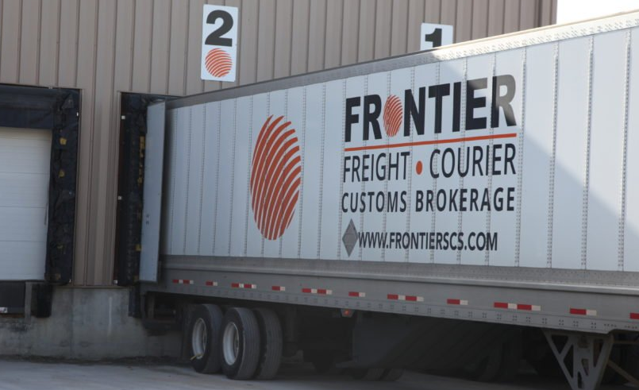
CONSOLIDATION
WHAT IS CONSOLIDATION?
Instead of shipping each product individually, under international shipping rates, you can combine all LTL and/or parcel shipments onto one bill of lading

Slide 15
BENEFITS OF CONSOLIDATION
$1000
$30
$20
$50
$50
$30
$20
Non-Consolidation:
$50
$30
$20
$1000
$20
$80
$30
$20
Consolidation:
$20

Slide 16
SUMMARY
IMPROVE CUSTOMER SATISFACTION
By making it easier for your customers to do business with you, you can grow your sales to be 10-15% of what you do in the U.S.
LOWER OVERALL COSTS
By consolidating LTL and small parcel shipments, there is a drastic reduction in cross border freight spend
FAST DELIVERY TO YOUR CUSTOMERS
Reducing border delays, and zone skipping through consolidation, ensures quick delivery to your customers across Canada
STREAMLINE NORTHERN BORDER OPERATIONS
Make your business more attractive to do business with at the start, to immediately gain a competitive advantage for short and long term growth

