Slide 1
CANADIAN CUSTOMS BROKERAGE
Presented by

Slide 2
FRONTIER’S SERVICES
FRONTIER IS A PRIVATELY OWNED, CANADIAN-BASED CUSTOMS BROKERAGE & COMPLIANCE PROVIDER
TRANS-BORDER LOGISTICS
CANADIAN CUSTOMS BROKERAGE
USA CUSTOMS BROKERAGE
INTERNATIONAL FORWARDING
FREIGHT & COURIER
TRADE COMPLIANCE

Slide 3
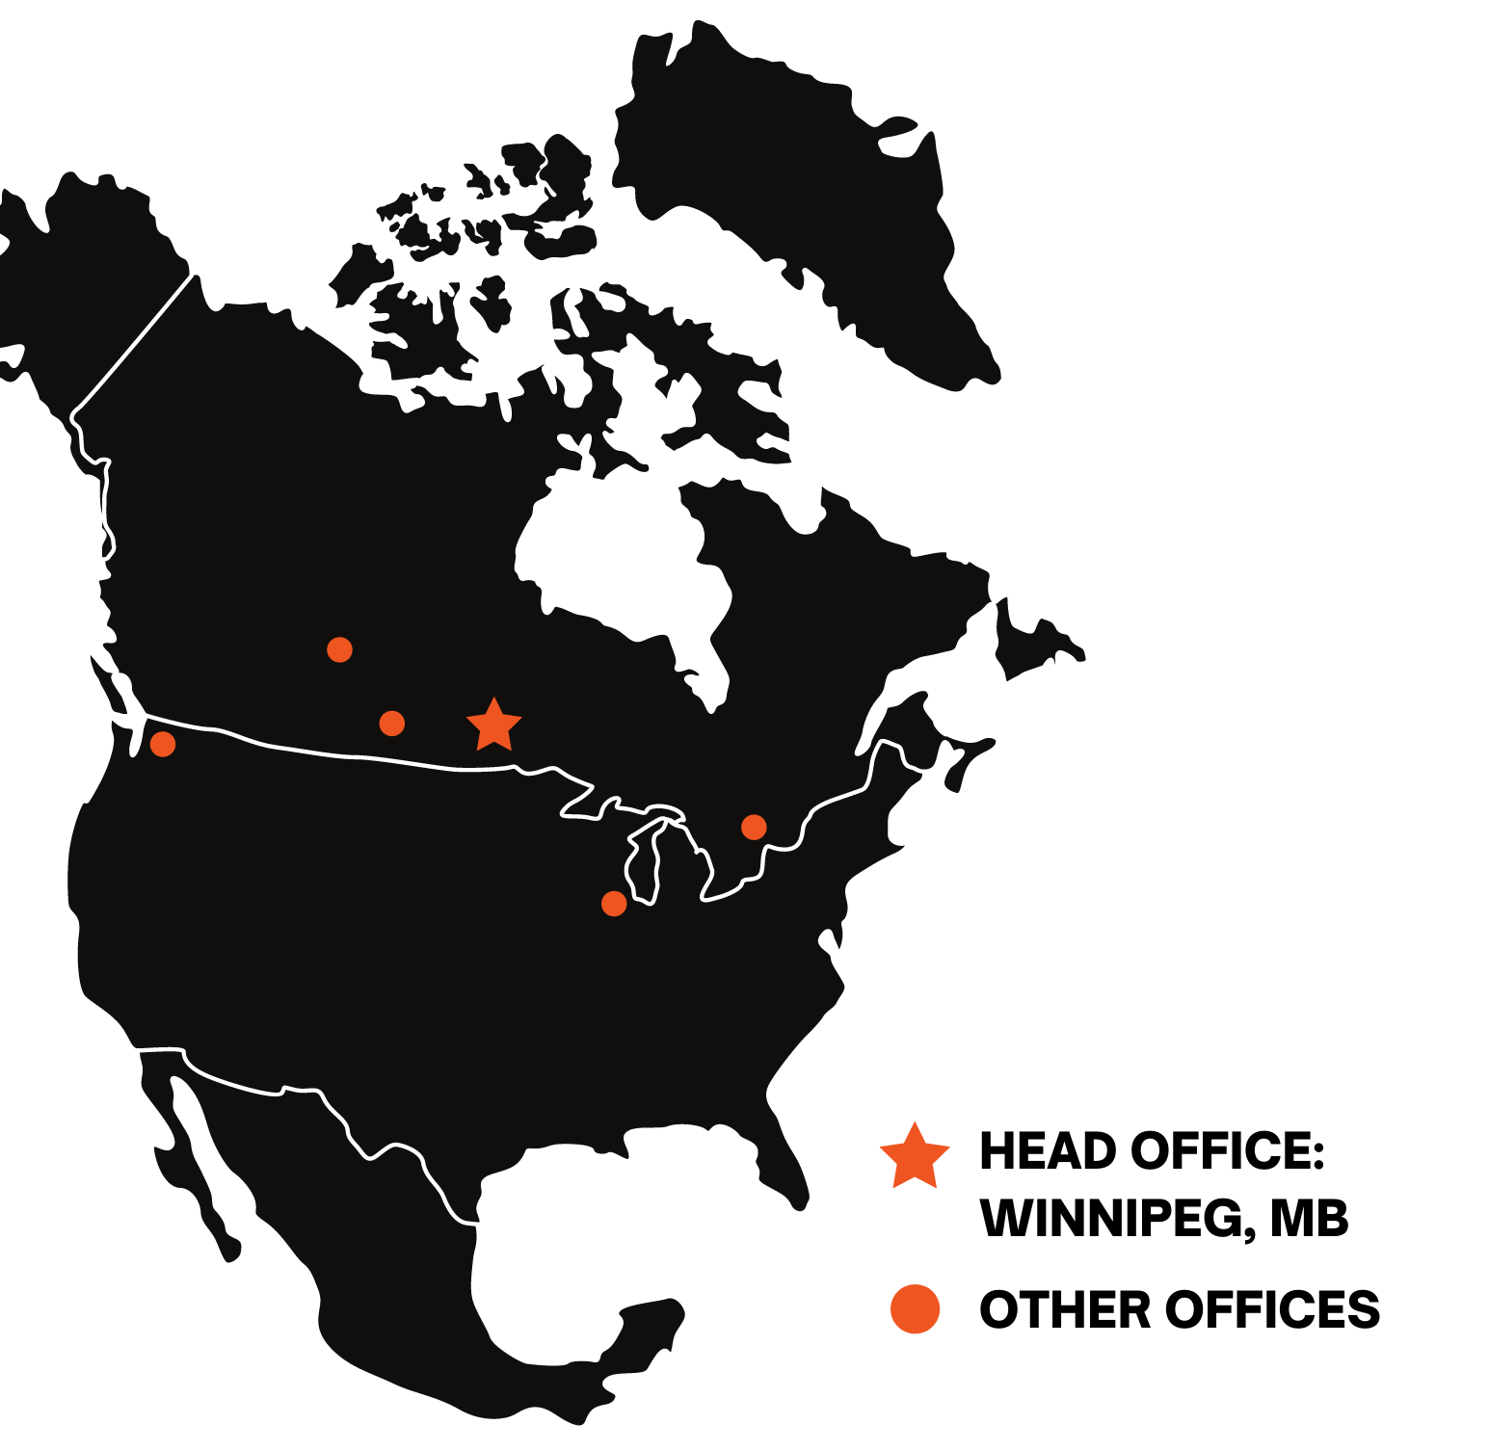
FRONTIER’S OFFICES
WHO ARE WE?
Frontier employees 250+ individuals throughout North America
Customers and reputation built on a “Customer Service First” Approach
LOCATIONS
Winnipeg, MB Canada
Toronto, ON Canada
Regina, SK Canada
Saskatoon, SK Canada
Chicago, IL USA
Seattle, WA USA

Slide 4
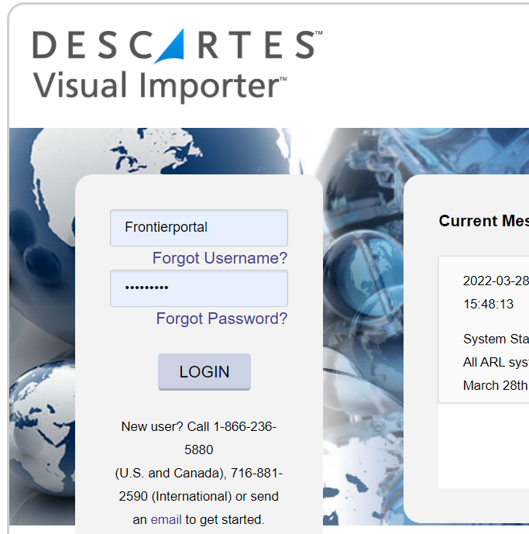
TECHNOLOGY – VISUAL IMPORTER
VISUAL IMPORTER
Visual importer is an online portal that provides complete visibility and is used for CBSA reporting requirements.
FEATURES:
View your B3s,
Invoice imaging
Real time status of shipments and reports

Slide 5
VISUAL IMPORTER – SHIPMENT STATUS
SHIPMENT STATUS
Providing complete visibility is a top priority at Frontier.

Slide 6
VISUAL IMPORTER – SHIPMENT MANAGER
SHIPMENT
MANAGER
Frontier customers can manage and review entries in real time

Slide 7
VISUAL IMPORTER – SHIPMENT MANAGER
PART DATABASE MANGEMENT
SOA AND ARL MANAGEMENT

Slide 8
FRONTIER CUSTOMERS
HIGH CUSTOMER RETENTION
10+ YEARS OF SERVICE:
We provide over 150,000 entries per year for our current customers.
METC
STRONGCO LIMITED
WEBER GRILLS
CURRENT CUSTOMERS
HATCO CORPORATION
FEDERATED CO-OPERATIVES
Our current customers range from large multi-national corporations to small start-ups and everything in between.
Currently providing CDN Customs Brokerage Services for over 300 customers
OTHER CDN BROKERAGE CLIENTS

Slide 9
SUMMARY
POINT 1
Point 1 paragraph
POINT 2
Point 3 paragraph
POINT 3
Point 3 paragraph
POINT 4
Point 4 paragraph

