Slide 1
CUSTOMER SERVICE & LAST MILE DELIVERY

Slide 2
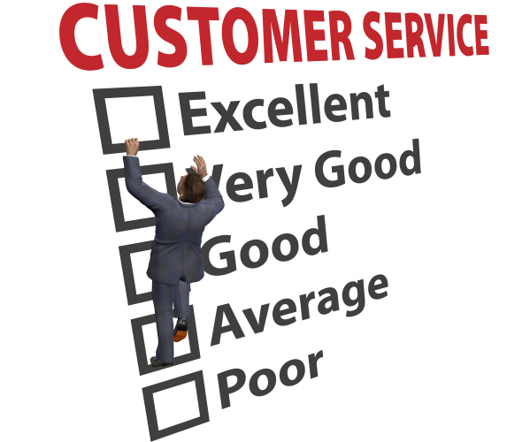
Table of Contents:
How to answer the phone
What is the call about?
How to find the team responsible
How to put the caller on hold
Transferring a call
Shipment Tracking
How to search for Consumer on ‘Track N Trace’
How to Search for the Consumer on A1
Verifying Information
Carrier’s tracking and contact info
What is ETA
Status of Shipment
What information to share with the Consumer
Time restraints
How to check on other carrier’s website
Carrier’s policies and definition
Create notes on A1/’Track N Trace
Why to Consumers get upset in the first place?
Words to use (Phrases to say or not say)
The Bouncing Back Concept
Example Call ( Role Play ) QUIZ

Slide 3
Customer service
If we say that our customers are our #1 priority but they can never get a hold of us, then what message are we really sending?
With the advent of e-mail, most of us have taken to avoiding the phone at all costs.
The thing is that a 5 minute phone call can often do the work of 5 e-mails with hefty attachments. “Think of how long that would take you,”
As we rely more and more on e-mail, we start to lose some of our phone skills.
This is a problem because when we are on the phone , how we speak and what we do has a big impact on the company.
It can take 4 – 5 good connections to make someone forget one bad connection.

Slide 4
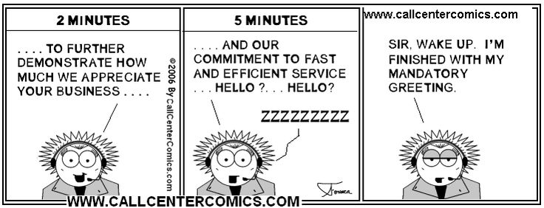
How to answer the phone
Greeting
Answering a phone call in a friendly and polite manner sets the way a call will carry on.
Main components to a basic greeting:
Hello,
Frontier Supply Chain Solutions (Company Name)
Your First Name
Question: Ask for assistance i.e “How can I help you?”
Ex: “Thank you for calling Frontier Supply Chain Solutions, my Name is Suzette, how can I help you?”

Slide 5
What is the phone call about?
The best way to complete a call is to decipher what the call is about at the beginning of your conversation. The faster you figure out what they need, the more time you have on resolving their issue.
PARS /Import?
Tracking number/Trace a Shipment?
Accounting/billing Issue?
PAPS/ Export?
Sales Call?
Line haul/Logistics call?
Local Courier Call? Wpg, SK or Tor?
HR? Hiring?
Driver Safety?
Apple Express?

Slide 6
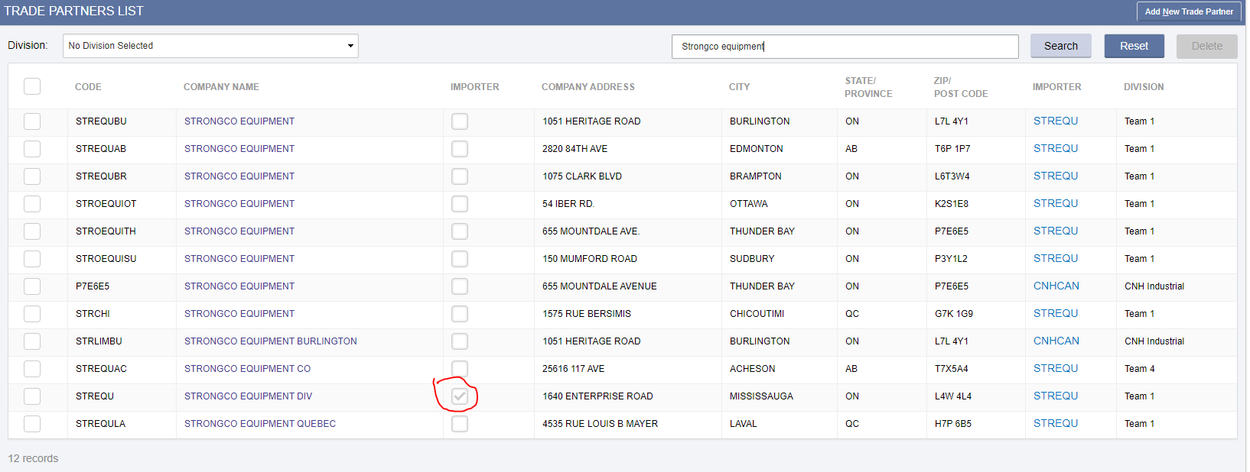
How to find the team responsible
PARS, Brokerage related questions
On Visual Importer : Click Shipment Entry.
Sign into Visual Importer and go to Trade Partners → Trade Partners List
In the search Line, type in the name of the Client.

Slide 7
To find the team responsible
FREIGHT, Logistics related questions
On A1,click on companies tab.
Type in the company/Client name in the “Search for” display box
Select correct company/Client
Click on the User Columns and the ISR and assigned team will be visible.

Slide 8
To find the team responsible

Slide 9
Transferring a call
Top things to do before transferring calls:
If you find out the caller has already been transferred, try to resolve their call without transferring. Sometimes callers get upset when they are transferred too many times.
Ask the person who you are transferring to and confirm if they can handle the caller’s issue.
If you have confirmed whom you are going to transfer to, explain to the caller why you are transferring
Give them correct name and phone# of who you’re transferring to.
Make sure you call someone at the other end before you transfer.
Explain what the caller wants before you complete the transfer

Slide 10
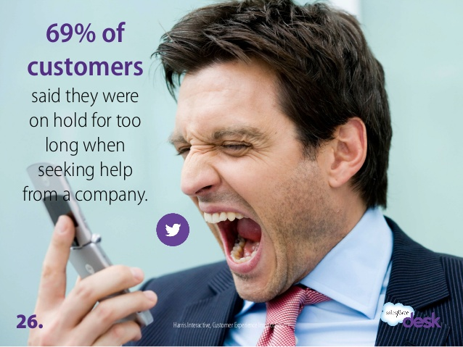
How to put the caller on hold
Putting someone on hold:
Advise the caller that you are putting them on hold
Let them know how long the wait will be
Do not put them on hold more than a couple of minutes without checking on them, retrieve the call and advise them they will be on hold longer.
Giving them the option of calling them back at a set time if you are unsure of getting a response to them right away.
Remember to thank them for holding

Slide 11
Shipment tracking:
Searching Customer/Consumer on Track & Trace Site
To find a Customer/Consumer on Track & Trace:
PFS #
Tracking number (WAYBILL #, PRO#) (ie. Loomis # FSC, Label # LDC)
Reference # (Sales Order #, PO #)(ie. Dometic SO#, RGA #)
NOTE:
Must be keyed exactly ( case sensitive)
If there is a digit missing or too many digits, the shipment will not pull up.
Consumer = End User
Customer= Client/GST paid/Freight prepaid
http://192.168.1.211/WebTrackDEV/views/Frontier/FrontierDetails.xhtml

Slide 12
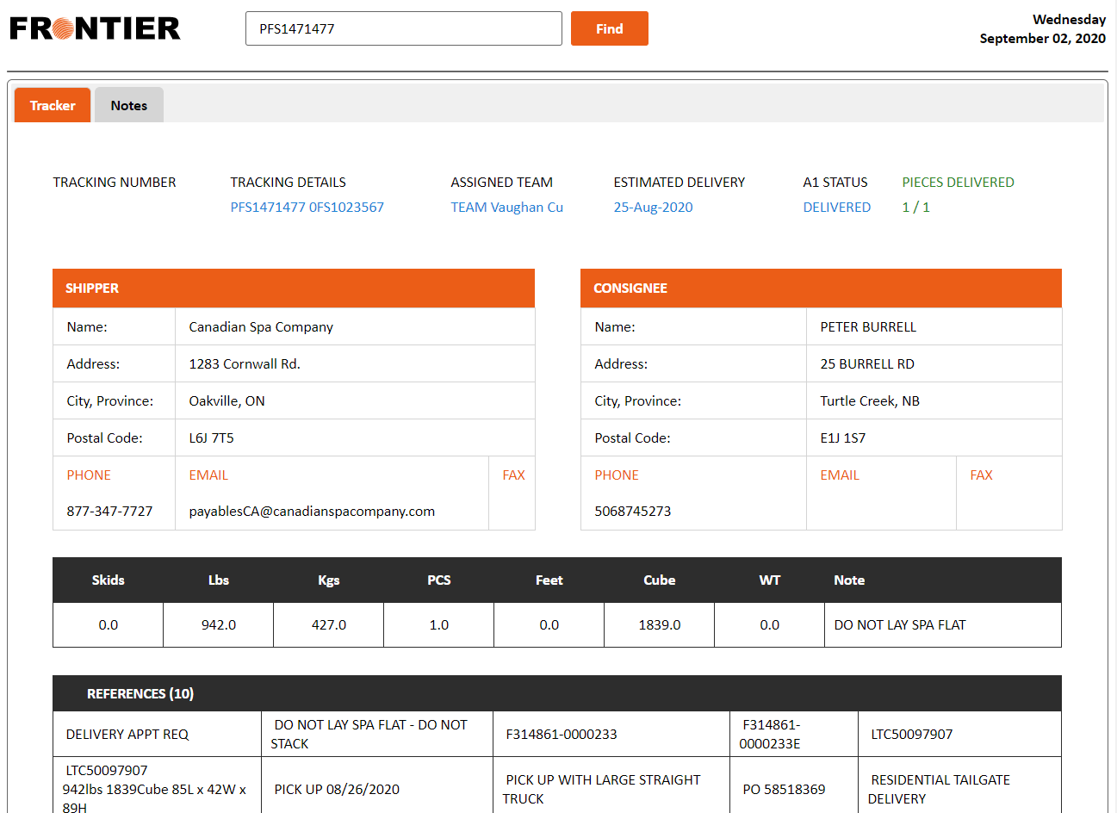
Searching Consumer/Customer on Track & Trace Site
http://192.168.1.211/WebTrackDEV/views/Frontier/FrontierDetails.xhtml

Slide 13
Searching Customer/Consumer on Track & Trace Site
http://192.168.1.211/WebTrackDEV/views/Frontier/FrontierDetails.xhtml

Slide 14
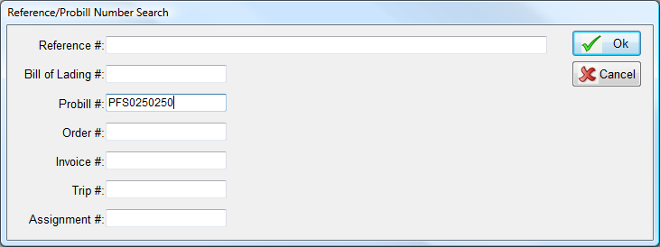
Shipment tracking:
Searching the Customer/Consumer in A1
To find a Customer/Consumer on A1:
PFS # (Tracking number)

Slide 15
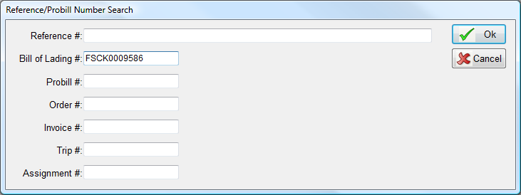
Searching the Customer/Consumer on A1
Tracking number/ Waybill# (Loomis waybill #)

Slide 16
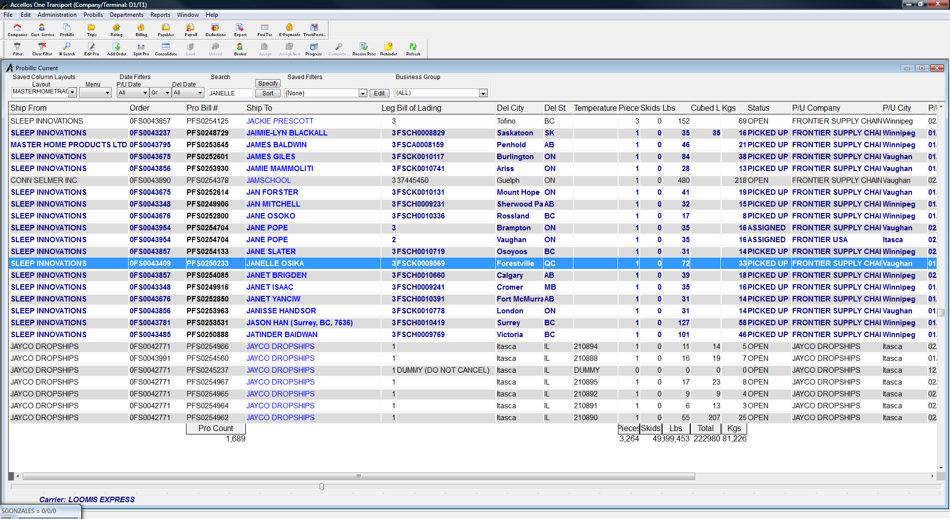
Searching the Customer/Consumer on A1
Alternative ways to track a customer/consumer's order:
-Name or Company Name

Slide 17
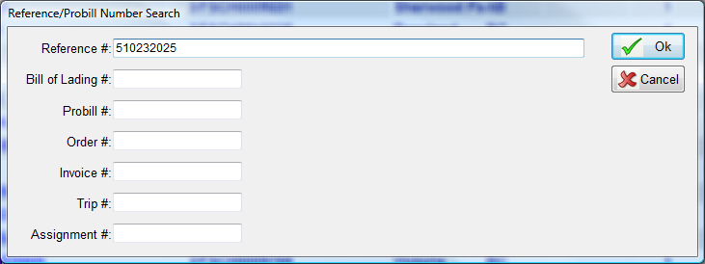
Searching the Customer/Consumer on A1
Customer Sales Order#/Reference#

Slide 18
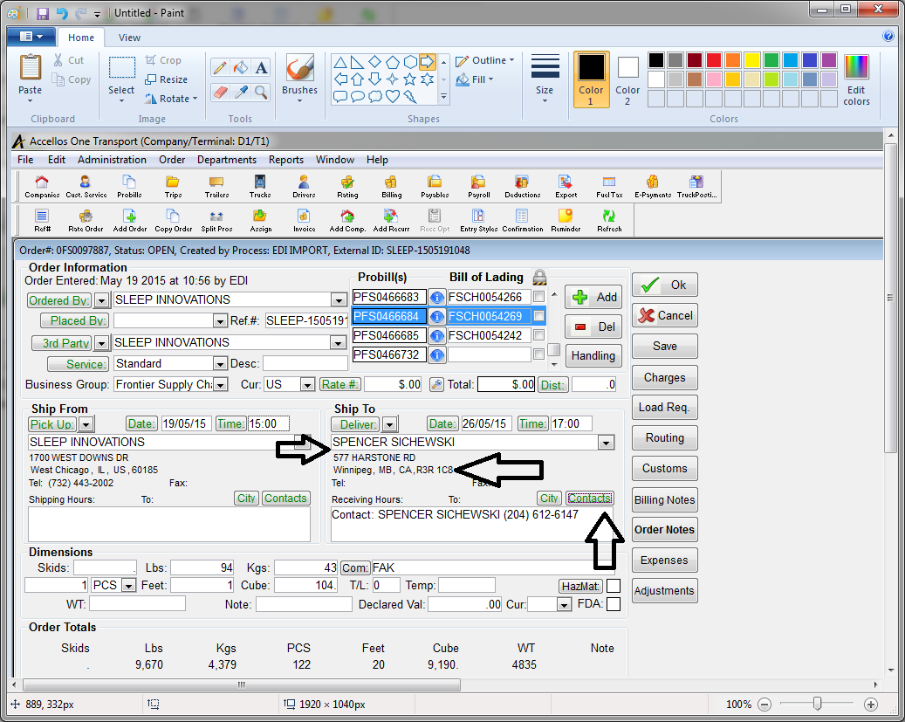
Verifying Information
Delivery address / callback # / Name

Slide 19
Carrier’s Tracking and Contact info
(Check spreadsheet) , common ones below
Carrier | Tracking number
Loomis/DHL Preferred Preferred@loomis-express.com Anna DeAngelis, Anna.DeAngelis@loomis-express.com http://www.loomis-express.com/ca/wfTrackingForm.aspx | DZMAB0700043 FSCR0020366 FSCK0055482
Midland Courier Jones, Natalie Jones.Natalie@midlandtransport.com Midland Transport Jennifer Raiche, Raiche.Jennifer@midlandtransport.com customerservice@midlandtransport.com https://www.midlandtransport.com/ShipmentInquiry.aspx | LDC50125339, P00113055829 90725988
Vitran Express TOR CS TorCustomerService@vitran.com narinder.sharma@vitran.com erica.dolan@vitran.com http://www.vitranexpress.com/canadian_ltl/home/index.htm | In A1 – 774051007 Eight digits only – drop the last digit !
Day and Ross FRIESEN, KEVIN Kevin.FRIESEN@dayandrossinc.ca Rebecca Ward: rebecca.ward@dayandrossinc.ca TLC@dayandrossinc.ca http://www.dayross.ca/Forms/TrackShipment.aspx | TOR4387463 – starts with whatever city it is departing from.
Gardwine North http://205.200.119.2/scripts/cgiip.exe/protrace.htm | Can be similar to Midland transport, sometimes with TTO/WPG to start.

Slide 20
ETA ??
“Estimated” time of arrival
Estimated day of shipment delivery
No Guarantees

Slide 21
Status of Shipment
Where is the shipment at ? Location?
Is the tracking information up to date?
If tracking is not updated ?
Follow up with Carrier
Call back customer with updated info!

Slide 22
What information to share with the Consumer/Customer
It is important to know what it means to give “too much information”
DO NOT tell the Customer/Consumer any of Frontier rates
DO NOT provide Carriers of any rates
DO NOT provide the carrier’s phone number or contact
DO NOT tell them to contact our carriers.
DO provide only the information that is necessary
DO look through the notes for references to assist you
DO advise customer if they ask for further information about their shipment, they should contact Frontier

Slide 23
Time restraints
Most carriers do not have a specific time to attempt deliveries. They are usually delivery windows or time ranges.
Loomis is : Mon – Fri 9AM to 5PM
Local Frontier Carriers (Winnipeg or Vaughan) : Mon – Fri 9AM to 5 PM
Evening Deliveries(only available for Endy): Mon- Fri 6PM to 9PM
If the customer would like a morning delivery( 8AM to 12PM), we will need to find out from the Carrier first if this option is available.
Evening deliveries are not available unless the CLIENT has agreed to this service or if it clearly states on A1 “EVENING DELIVERY”. If you are unsure , advise the consumer that you do not have this information and that the ISR/Team will contact them back.
Be sure to not offer any special services to the consumer unless you have been confirmed that is it available.

Slide 24
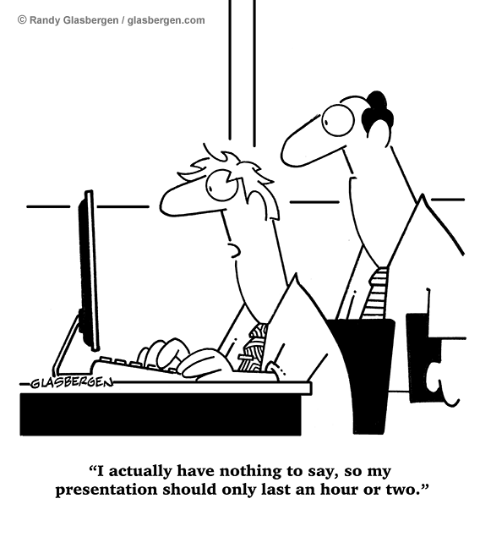
How to check on other carrier’s website
Demonstration on Computer

Slide 25
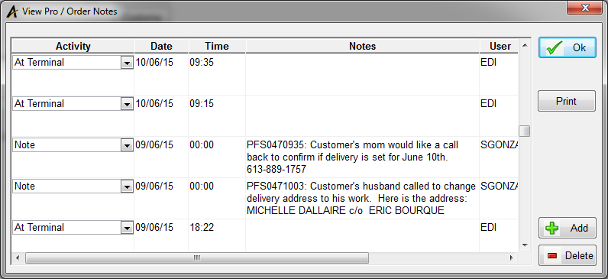
Notes in A1
http://192.168.1.211/WebTrackDEV/views/Frontier/FrontierDetails.xhtml
Helps to update the team and ISR
Also used for billing purposes

Slide 26
Carrier’s policies and procedures
LOOMIS (General Policies for most carriers)
All deliveries are defaulted for a signature from anyone who answers the door. They do not need proof of credit card or ID to sign. If consumer wants shipment left at the Door without signature, they will need to leave a note for the Driver with their signature. (excluded: APT, Condos or Gated Community)
All deliveries are considered curbside. If the customer is home to accept the delivery, driver can deliver up to the door or to the driver’s digression, assistance from the consumer maybe required if the shipment is over 100lbs. Drivers/Carriers have a liability issue entering the consumer’s home or business so they are not allowed to enter the premises to assist or carry the shipment into the place.
Loomis does not allow delivery appointments. After the 2nd attempt is made, it is held at the closest depot to the address. We can offer a 3rd attempt to the consumer. This will be an extra charge to Frontier. (Please be sure to advise your Client and charge them for this service, ISR/Team responsible will make this call)
In some cases, if it is a shipment that is larger than 100 lbs, Loomis will have this shipment held at the depot and attempt to call the consumer to arrange the delivery. (This is very common if the shipment arrives to a smaller depot)
If the customer lives in an apartment or a condo, it is required that the buzzer code information be listed or available to Loomis before delivery, otherwise, shipment will be held at the depot until Consumer or Shipper contacts Loomis with the information.
Deliveries to apartments with no elevators, Drivers will not deliver shipments to the apartment door.
Shipments can be left with the concierge/security/property manager if that option is available to the consumer.

Slide 27
Carrier’s policies and procedures
Local Carrier Network Delivery
Deliveries to Businesses
All deliveries are made during business hours, if carrier sees the business is close they will attempt again the next following business day.
Deliveries to Residences
Deliveries do not require a signature and shipments are left at or near the door/curbside. If Driver feels that is it unsafe to leave shipment at the premises, driver will leave a Notice on the door that they have attempted delivery.
Consumers can call ahead and authorize NSR (no signature required) if they wish to have this shipment left at the premises
If the consumer lives in an apartment or condo, local carrier will call ahead of time to schedule delivery appointment.
All deliveries are made during weekdays
If you need to change address, change delivery or re-delivery date, please be sure to request this from the Team/ISR that handles it as they will provide further details if there are any issues with delivery.
If consumers are requesting for special delivery requirements, local carrier will not proceed unless they have authorization from Frontier, also contact Team/ISR first and see if these special requirements are approved.
LTL Carrier
All LTL carriers will require to contact the receiver before making delivery attempt as these shipments are over 150LBS

Slide 28
Why Do Consumers Get Upset in the First Place?
Deadline is missed
The order or service is incorrect
They were treated rudely or unprofessionally
They were given the wrong information
They are unhappy with the product or service

Slide 29
Words to use (Phrases to say or not say)
Instead of saying... “I don’t know”
Try saying... “I will find out”
Instead of saying... “No”
Try saying...”What I can do is ....”
Instead of saying ... “ That’s not my responsibility”
Try saying “This is who can help you”
Instead of saying “You’re right- this is pretty bad”
Try saying... “I understand your frustrations”
Instead of saying... “That’s not my fault”
Try saying... “Let’s see what we can do about this”

Slide 30
Words to use (Phrases to say or not say)
Instead of saying... “You need to talk to my manager”
Try saying... “Let me talk to my manager and will get back to you”
Instead of saying...”You want it by when”
Try saying...”I’ll try my best”
Instead of saying...”Calm down”
Try saying...”I’m Sorry”
Instead of saying... “Call me back”
Try saying...”I will call you back”

Slide 31
The Bouncing Back Concept
Let them vent
Say you are sorry
Fix the problem
Go above and beyond for the customer

Slide 32
Let them vent
Zip your lip!
Give clues that you are listening
Don’t take it personally

Slide 33
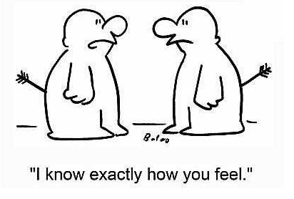
Say You are Sorry
Express empathy
Key empathic phrases:
I can see why you feel that way
I see what you mean
I can understand how frustrating this must be
I’m really sorry about this

Slide 34
Solve the Problem
Ask questions
Double check the facts
Mutually Agree on a solution
Follow up

Slide 35
Go Above and Beyond
Need to prove ourselves
What can be done to ensure the problem doesn’t happen again
Sometimes just being good isn’t enough

Slide 36
QUIZ TIME!

